Slide 1
Dan’s Bagel Shop Interactive Web-Based Storefront
Team 7even
Tyler Beck – Full-Stack Integrator
Kaden Hellewell – Front-end Webpage Designer
Jonas Knudsen – Back-end Database Manager

Slide 2
Project Overview
Design decisions
Used Django for flexibility and quick development
Web-based for easy access anywhere
Can host site on AWS in the future
Agile Development
Short scrum meetings held twice a week
Sprints held once every two weeks
As requirements changed or new issues found, we had to adapt our code designs, requirements documents, etc.

Slide 3
Requirement 9.1 – Integrate existing customers into the new system
FURPS – Supportability Requirement
An existing system already existed for old customers
Just moved the customers into the new system
Audience-oriented – Implementation Requirement
Once all customers are integrated into the new system, we won’t need it anymore
MOSCOW – “Must Do” Requirement
Need to support all customers, both new and old

Slide 4
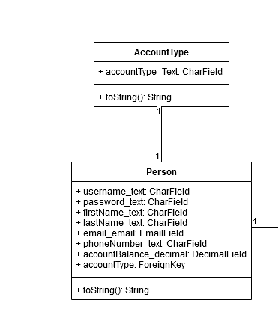
Requirement 9.1 – Integrate existing customers into the new system

Slide 5
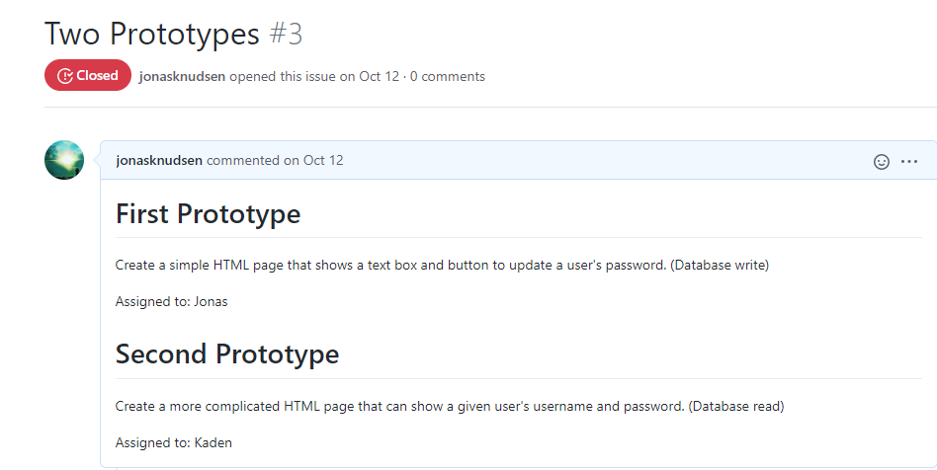
Requirement 9.1 – Integrate existing customers into the new system
Accomplished the database integration in the Prototypes created in Milestone 2
Team members:
Jonas – Wrote the database migrations
Jonas, Kaden, Tyler – All of us validated the database migrations and made suggestions to improve them on multiple occasions

Slide 6
Requirement 9.1 – Integrate existing customers into the new system
Design Choices
Used a Python Data Migration because of out-of-the-box support within Django
Did this in the Prototypes to demonstrate migration capability, but then got carried away and just finished the whole thing
Testing
Run the command python manage.py migrate in the src/djangoserver_cs3450/ directory
If no errors then the migration worked

Slide 7
Requirement 2.3 – Customers can Place Orders Online
FURPS – Functionality Requirement
Django server must be able to handle users placing orders
Reusability in using one order function to order various combinations of food items
Audience-oriented – User Requirement
Customer must be able to place an order online
MOSCOW – “Must Do” Requirement
Self explanatory; this is Dan’s Bagel Shop

Slide 8
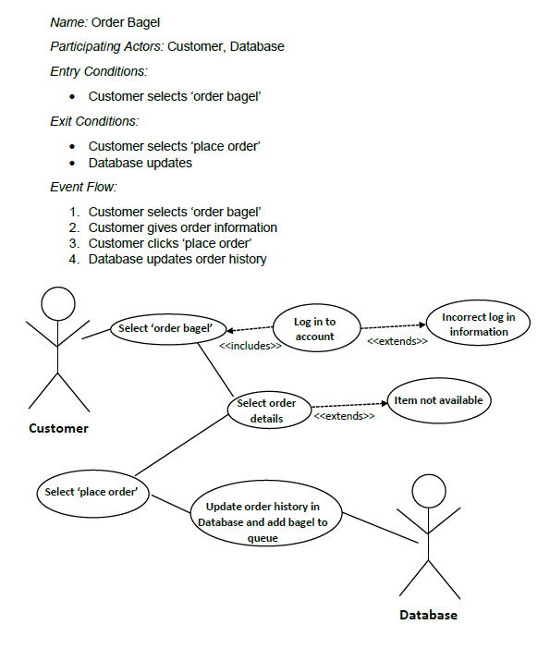
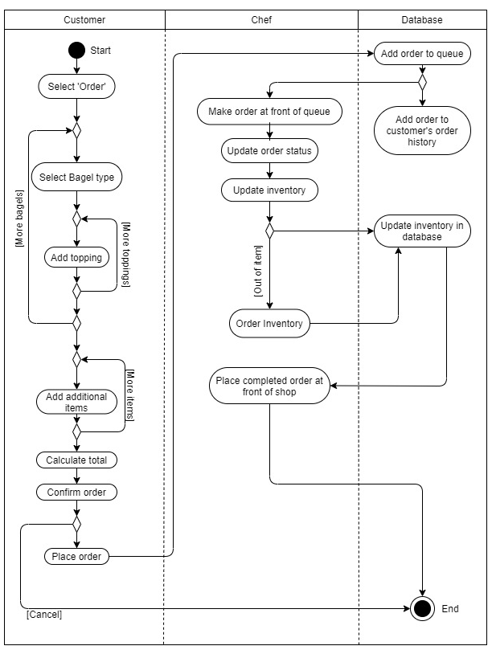
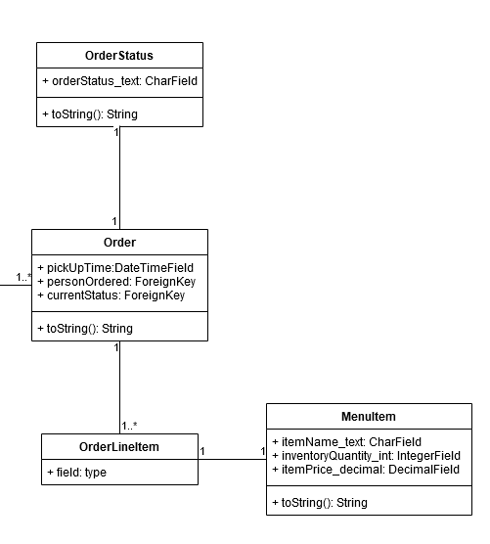
Requirement 2.3 – Customers can Place Orders Online

Slide 9
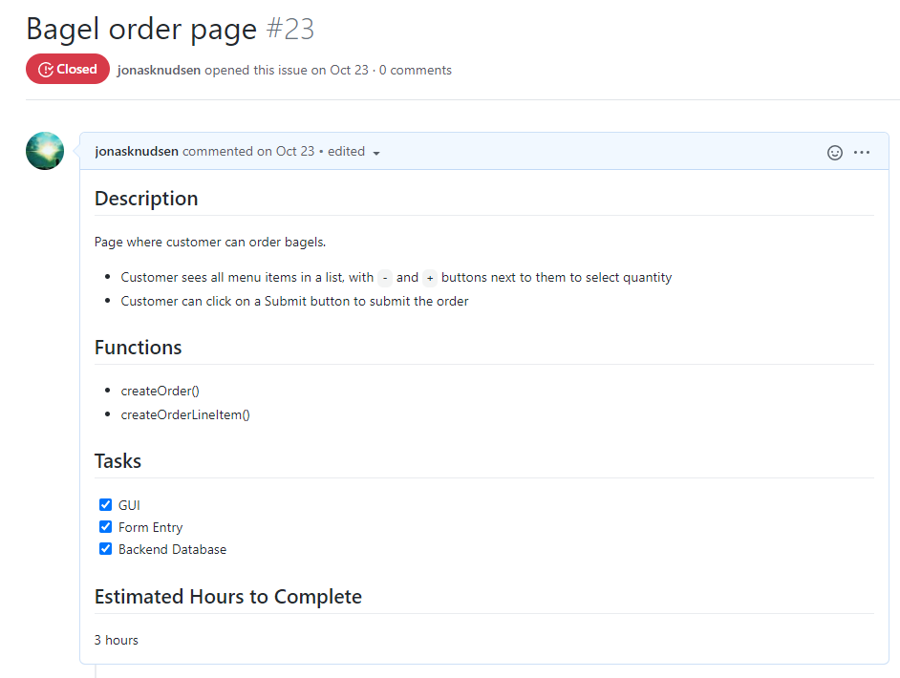
Requirement 2.3 – Customers can Place Orders Online
Accomplished placing an order in Milestone 3 Weeks 3-4 (second sprint)
Team members:
Kaden – Designed the GUI
Tyler – Wrote the function to pass information from the GUI to the database
Jonas – Wrote the database functions to handle order processing in the database

Slide 10
Requirement 2.3 – Customers can Place Orders Online
Design Choices
Parameters sent in using a Django view function
The front-end provides a UI for the user to select item, while the back-end handles the actual order processing
Testing
Run the command python manage.py test in the src/djangoserver_cs3450/ directory
If no errors then the order function worked

Slide 11
Requirement 3.1 – Chefs Can see incoming orders
FURPS – Usability Requirement
Incoming orders are sorted by due time
Chefs don’t need to dig into the database to get order information; it’s all presented nicely
Audience-oriented – User Requirement
Chefs must be able to view all online orders
MOSCOW – “Must Do” Requirement
Chefs must be able to know what bagels to prepare

Slide 12
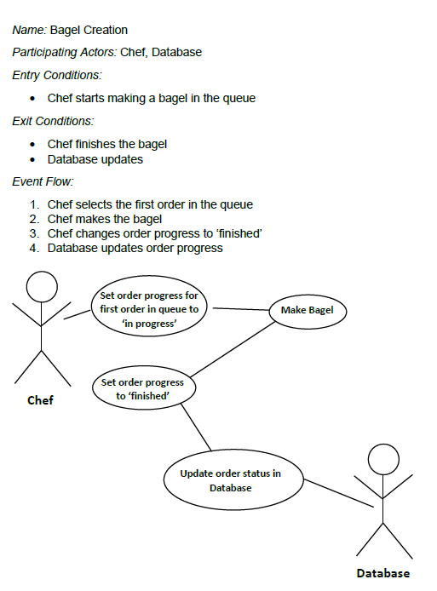
Requirement 3.1 – Chefs Can see incoming orders

Slide 13
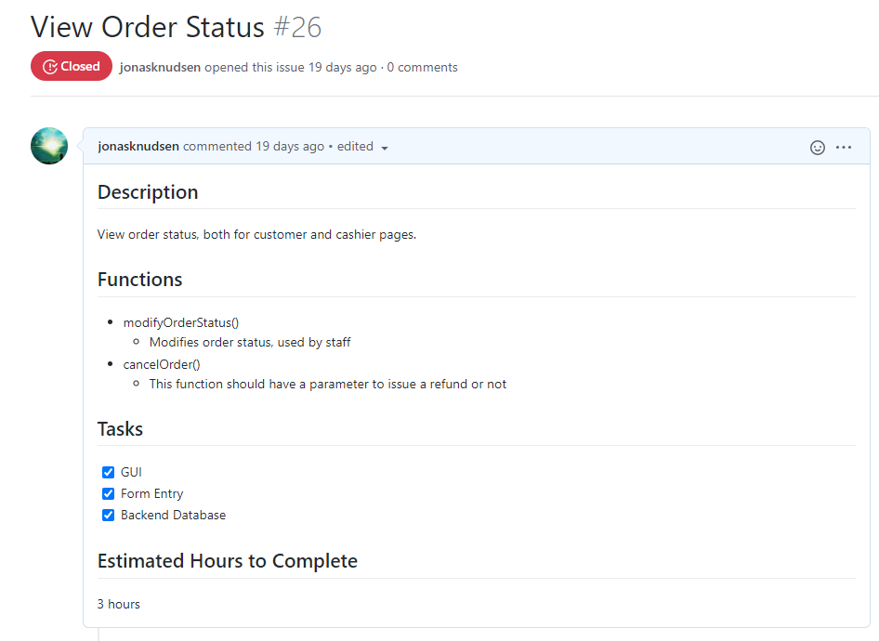
Requirement 3.1 – Chefs Can see incoming orders
Accomplished placing an order in Milestone 3 Weeks 5-6 (third sprint)
Team members:
Kaden – Designed the GUI
Tyler – Wrote the function to pass information from the GUI to the database
Jonas – Wrote the database functions to handle order processing in the database

Slide 14
Requirement 3.1 – Chefs Can see incoming orders
Design Choices
Parameters sent in using a Django view function
The front-end provides a UI for the chefs to see all orders, while the back-end handles the actual order processing
Testing
Run the command python manage.py test in the src/djangoserver_cs3450/ directory
If no errors then the order update / cancel functions worked

Slide 15
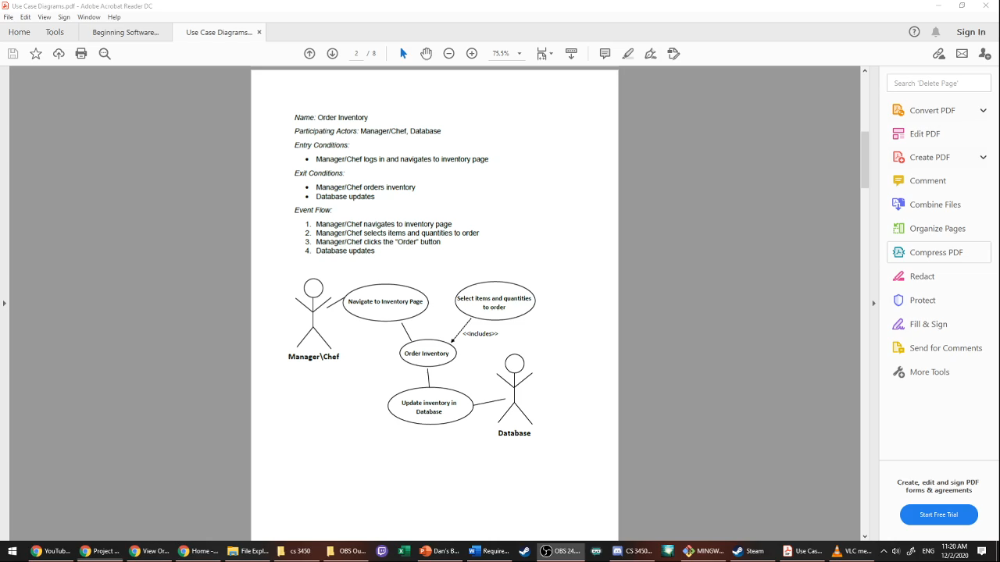
Video 1: Order Inventory

Slide 16

Video 2: Create Account

Slide 17
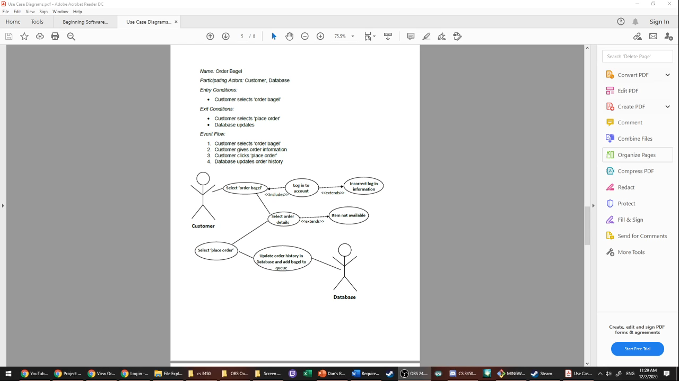
Video 3: Place Order

Slide 18

Video 4: Edit Menu

Slide 19
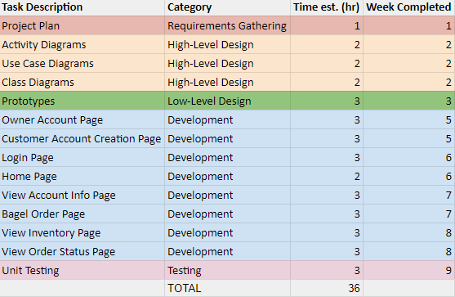
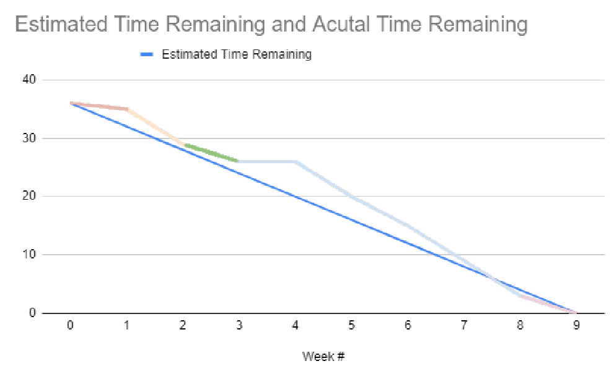
Burndown
Sprint 1: 1 hour / week, Sprint 2: 6 hour / week, Sprint 3: 4.8333 hour / week
Overall: 4 hour / week

Slide 20
Resources
Django. (2020, December 1). Retrieved December 2, 2020, from https://www.djangoproject.com/
How to use sessions. (n.d.). Retrieved December 2, 2020, from https://docs.djangoproject.com/en/3.1/topics/http/sessions/
MDN Web Docs. (2020, November 17). Retrieved December 2, 2020, from https://developer.mozilla.org/en-US/
Python 3.9.1rc1 documentation. (2020, December 2). Retrieved December 2, 2020, from https://docs.python.org/3/
Working with forms. (n.d.). Retrieved December 2, 2020, from https://docs.djangoproject.com/en/3.1/topics/forms/

Slide 21
Questions?

